Slide 1

Laue Crystals:
Flat and bent
Manuel Sanchez del Rio
srio@esrf.eu
Advanced Analysis & Precision Unit, MEG/ISDD, ESRF

Slide 2
Bragg & Laue crystal geometries
R
R
BRAGG
LAUE
T
T

Slide 3
Bibliography
Darwin (1914)The Theory of X-ray Reflexion Philosophical Magazine 27, 315
Ewald (1917) Zur Begründung der Kristalloptik, Teil III Die Kristalloptik der Röntgenstrahlen Ann. Phys. 54, 519
von Laue (1915) Die Theorie der Röntgenstrahlinterferenzen in neuer Form Encyclopaedie d. math Wiss 5,3, (1931) Ergebn. Exakt. Naturwiss.10133.
Zachariasen (1945) Theory of X-ray diffraction in crystals
James (1950) The optical principles of diffraction by X-rays
Taupin (1961) Théorie dynamique de la diffraction des rayons X par des cristaux déformés Bull Soc Fr. Mineral. 84 51
Takagi (1962) Dynamical theory of diffraction applicable to crystals with any kind of small distortion Acta Crystal 15 1311
Recent books:
Pinsker Dynamical Scattering of X rays in Crystals (1978).
Authier Dynamical Theory of X-Ray Diffraction (2001)
Shvyd’ko X-Ray Optics—High-Energy-Resolution Applications (2004)
crystalpy Guigay Sanchez del Rio JSR (2024)

Slide 4
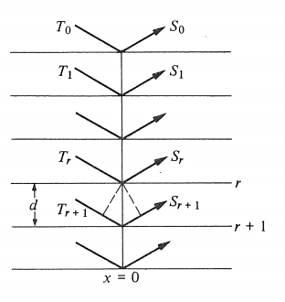
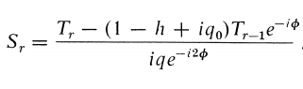
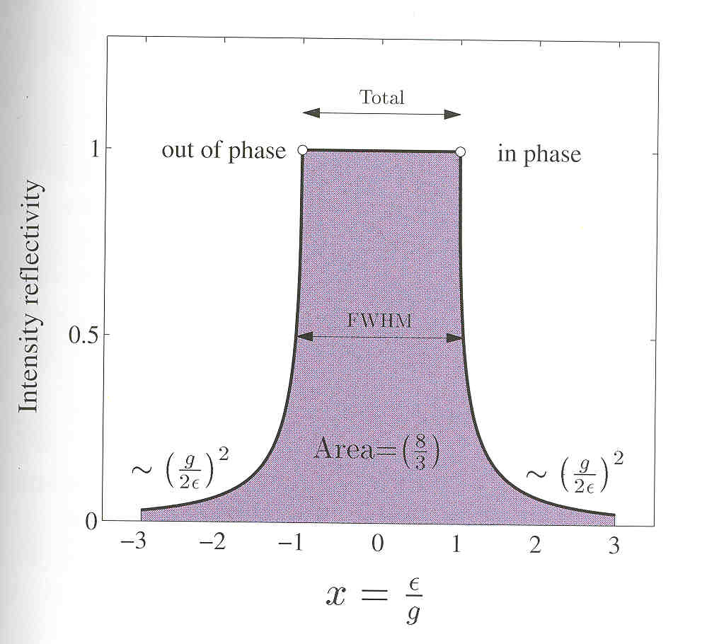
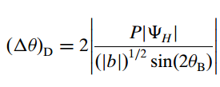
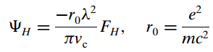
DYNAMICAL THEORY (1914) – the darwin width
DARWIN TREATMENT OF DYNAMICAL THEORY (1914) – the darwin width
20160912 Spectroscopy day-out srio@esrf.eu

Slide 5
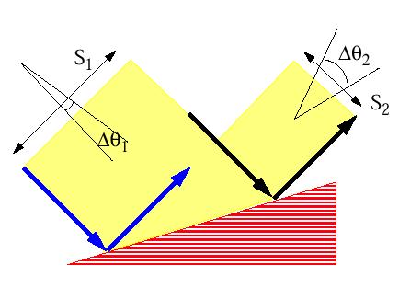
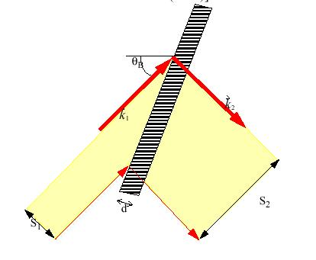
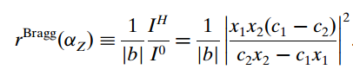
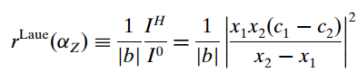
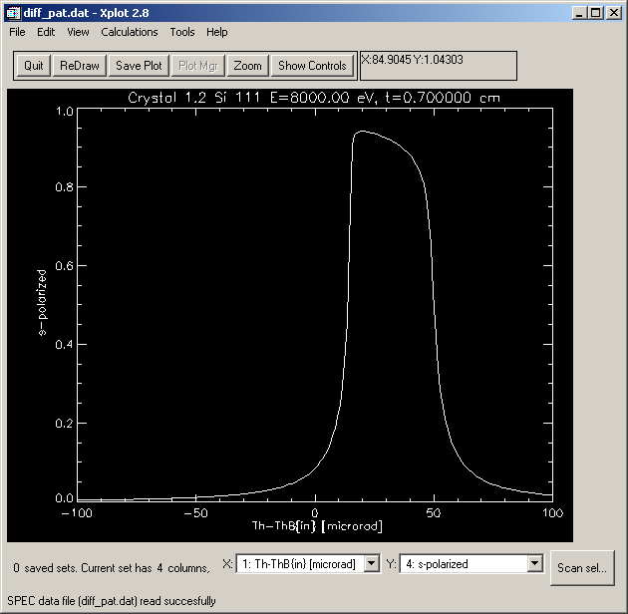
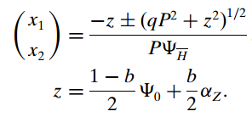
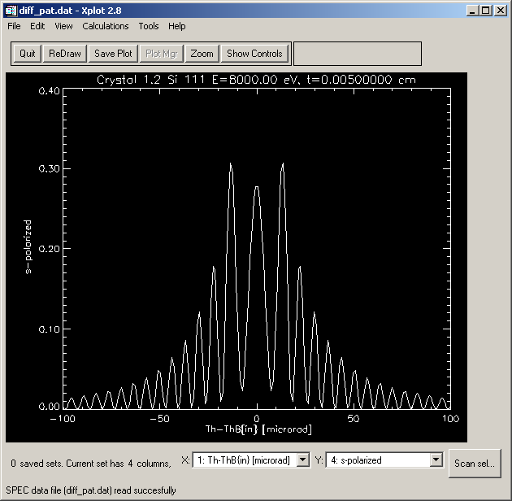
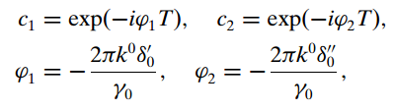
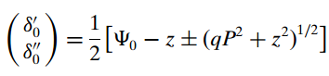
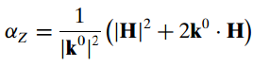
Zachariasen Formalism (undistorted)
BRAGG or reflection
LAUE or transmission

Slide 6
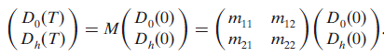
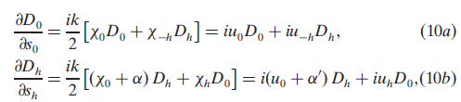
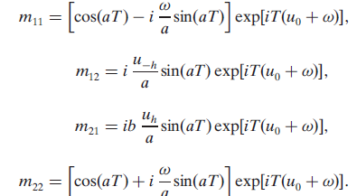
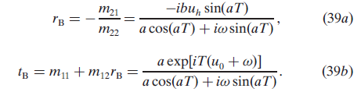
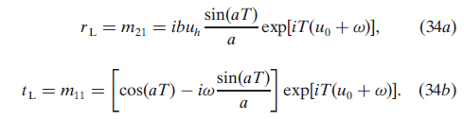
Guigay & Sanchez del Rio (undistorted)
Guigay and Sanchez del Rio (2024) https://doi.org/10.1107/S160057752400924X
R
R
BRAGG
LAUE
T

Slide 7
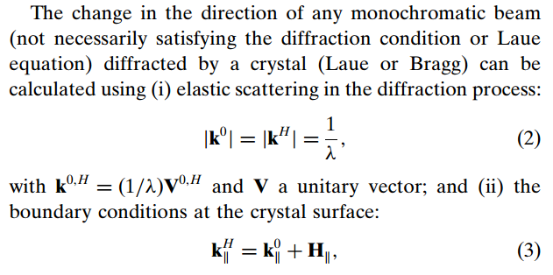
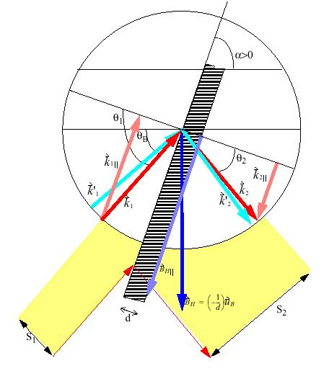
Geometrical model (surface model, no bulk effect)
20160912 Spectroscopy day-out srio@esrf.eu
Plane waves (incident and reflected)
Common intersection point on surface (no depth)
Symmetric Bragg is non-dispersive (specular). All other cases are dispersive (non-specular, like gratings or prisms)

Slide 8
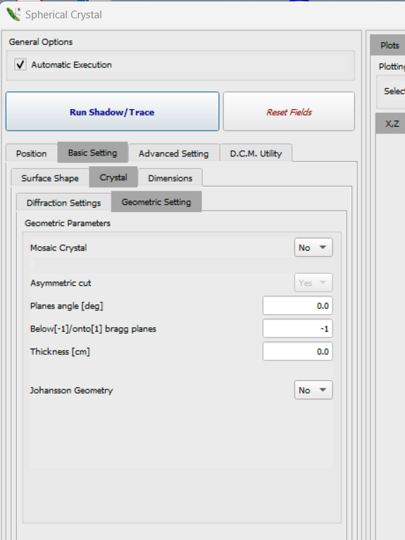
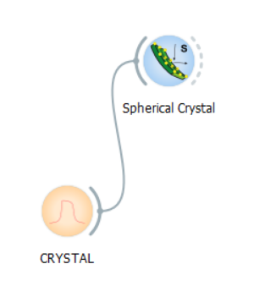

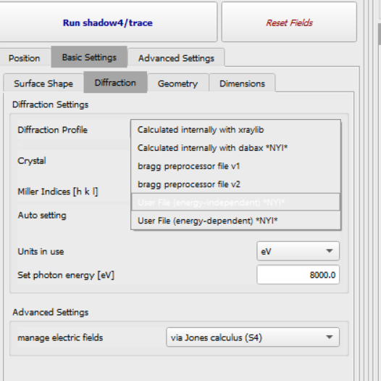
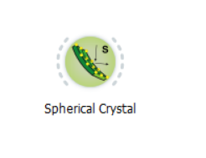

SHADOW4 Bragg only: flat and “bent but locally undistorted”
R
R
BRAGG
LAUE
SHADOW3
Limited applications
SHADOW4

Slide 9
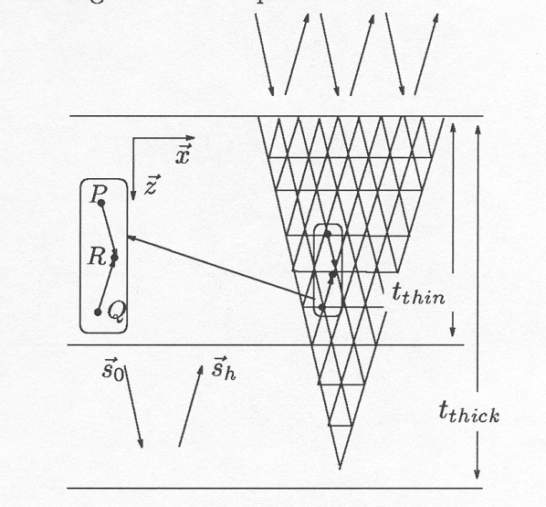
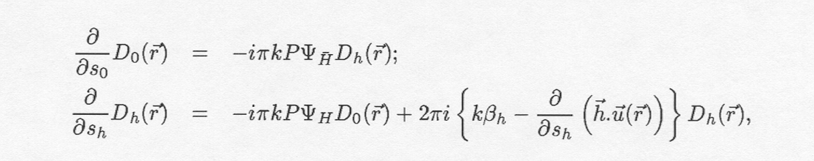

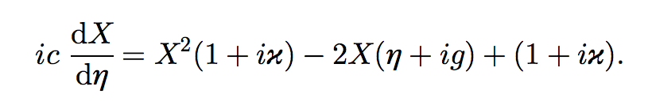
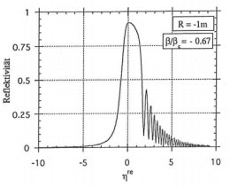
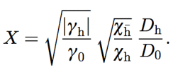
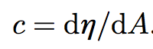
Distorted crystal (reflectivities)
Takagi, Acta Crystal 15 (1962) 1311
Taupin, Bull Soc Fr. Mineral. 84 (1961) 51
Analytical solutions of Takagi-Taupin (TT) only fow a few cases
Numerical integration of the PDF (2D)
Regular grids (Finite different methods) Authier, Epelboin, Gronkowski, etc etc
Finite Element Methods Ari-Pekka Honkanen
If deformation u(z) (e.g., uniform curvature) the PDEs reduce to a single ODE
See also: https://doi.org/10.1364/OE.409961
M. Krisch, Ph. Thesis (1993)
Hölzer et al. Cryst. Res. Technol. 33, 555 (1998)

Slide 10
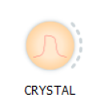
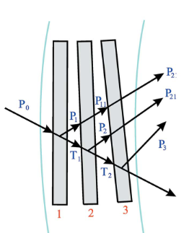
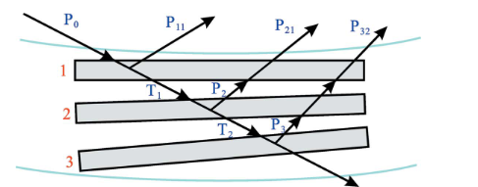
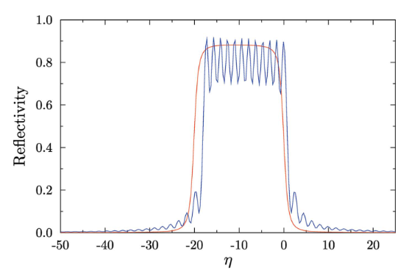
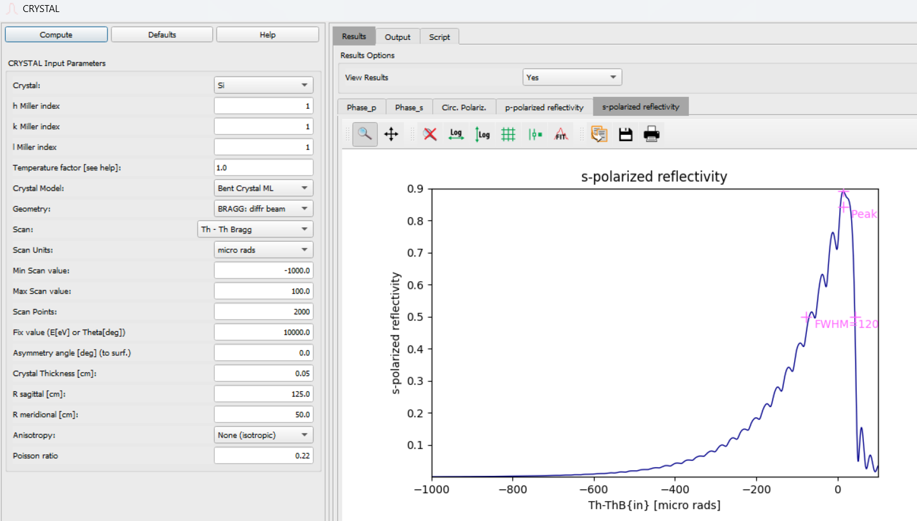
Approximated methods for bent crystals reflectivity Sanchez del Rio et al. (2015) https://doi.org/10.1107/S1600576715002782
R
R
BRAGG
LAUE
Multilamellar
Penning-Polder
Multilamellar

Slide 11
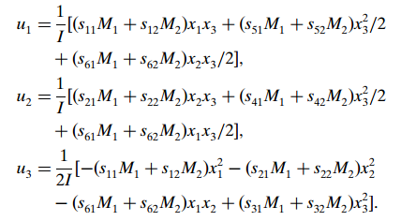
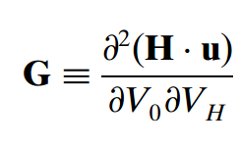
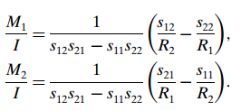
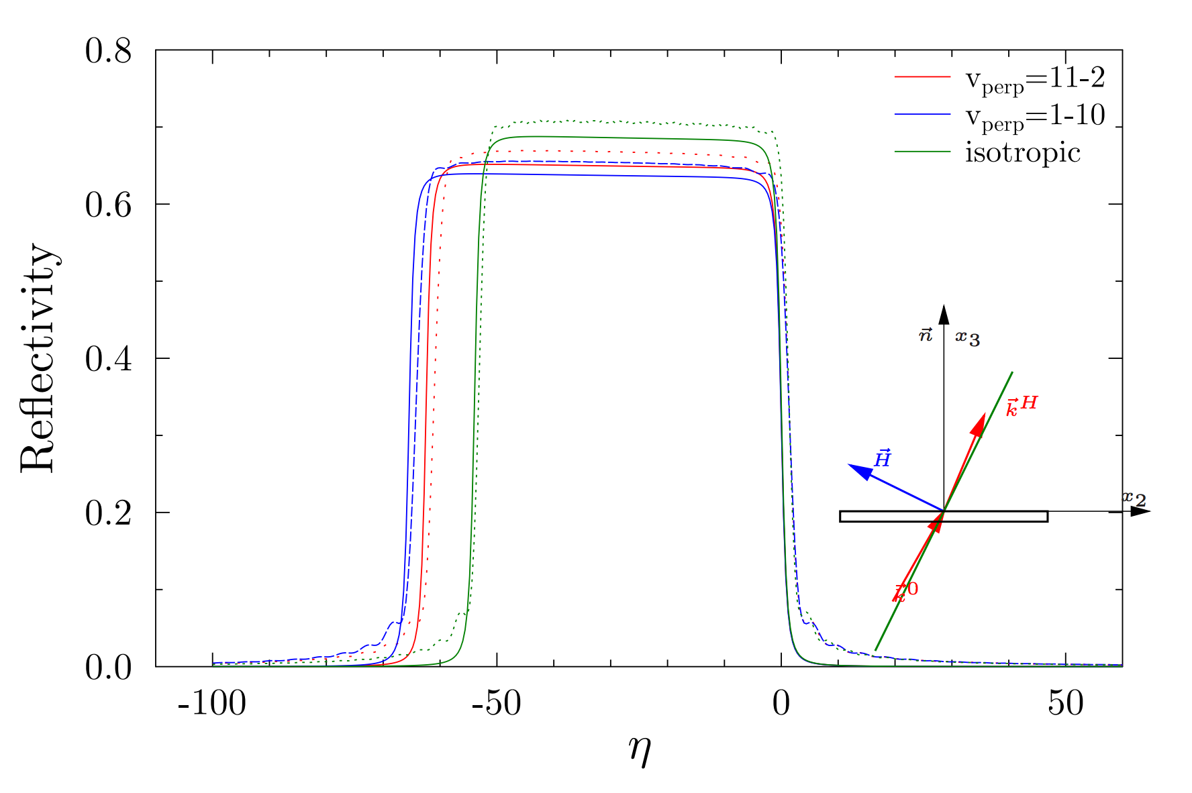
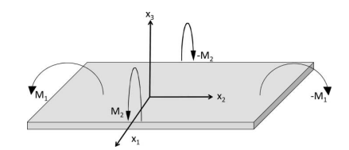
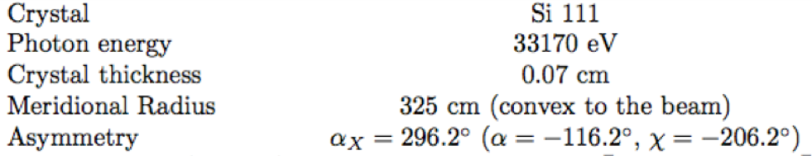
EFFECT OF CRYSTAL ANISOTROPY in bent crystals
111
11-2 or 1-10
M. Sanchez del Rio, N. Perez-Bocanegra, X. Shi & V. Honkimaki, J. Appl. Cryst. (2015). 48, 477-491

Slide 12
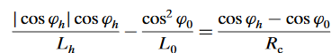
Focusing (Lens equation: monochromatic focus by surface) Guigay Sanchez del Rio https://doi.org/10.1107/S1600577521012480
R
R
LAUE
BRAGG
Not working
Bulk effect (Borrmann triangle)

Slide 13
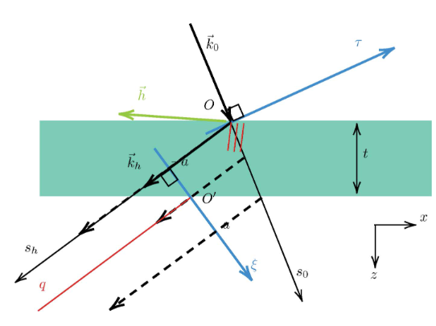
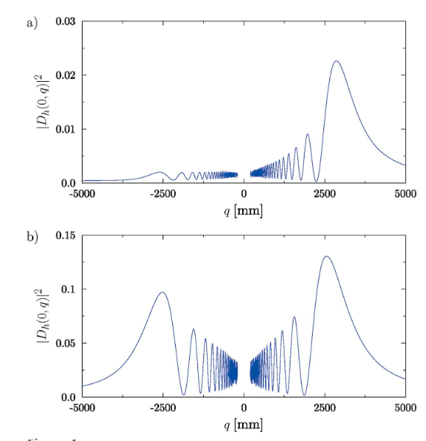
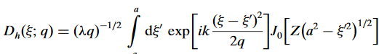
Focusing Borrmann triangle (monochromatic) Guigay Sanchez del Rio https://doi.org/10.1107/S1600577521012480
R
250 mm-thick flat Si111
8.3 keV
LAUE
17 keV
Plane incident waves gives non-plane reflected waves
From the quadratic phase we can obtain the focal position
Not possible to directly implement in ray tracing

Slide 14
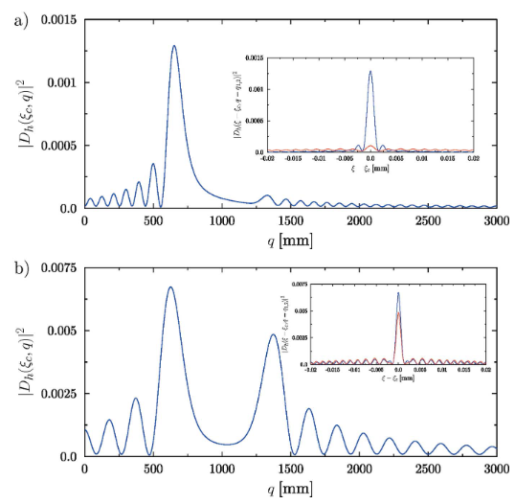
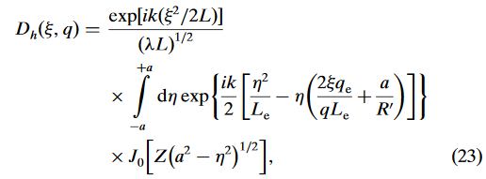
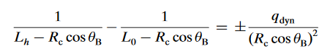
Focusing Borrmann triangle Guigay Sanchez del Rio https://doi.org/10.1107/S1600577521012480
R
250 mm-thick symmetric bent Si111
8.3 keV
LAUE
17 keV
Spherical Plane incident waves gives non-plane reflected waves
New lens equation
Only for symmetric Laue

Slide 15


Laue: polychromatic focusing effects
Polychromatic focusing with flat Laue crystals is fake focusing
Lateral Bragg angle variation
Suppose scattering on surface (no Borrmann considerations)
https://doi.org/10.1016/0168-9002(94)91905-4
http://dx.doi.org/10.1063/1.1146141

Slide 16

Laue: polychromatic focusing effects: Magic condition
https://doi.org/10.1107/S1600576720016428
https://doi.org/10.1117/12.2525449
Peng Qi, Xianbo Shi, Nazanin Samadi, Dean Chapman
See also: https://doi.org/10.1107/S0021889804023829

Slide 17




Laue-Laue monochromators
Beijing SRF: Wang et al. (2025) XOPPY+XRT https://doi.org/10.1107/S1600576724011841
ESRF
ID11 future cryogenic LL monochromator
Based on existing ID31 and ID15 monochromators
ID31 XOPPY reflectivity simulations (Penning-Polder)

Slide 18
More slides

Slide 19




PROJECT 2: STUDY OF CRYSTAL DIFFRACTION BY FEA
Takagi, Acta Crystal 15 (1962) 1311
Taupin, Bull Soc Fr. Mineral. 84 (1961) 51
R
R
BRAGG
LAUE
T
X-ray standing waves
X-ray topography
Grazing incidence diffraction
The angles involved are close to the critical angle. Fresnel specular theory predicts an evanescent wave, which must be treated by the dynamical theory.
S. Stepanov
http://x-server.gmca.aps.anl.gov/
The fluorescence signal is directly proportional to the internal wave field intensity at the atom position . The position of the fluorescing atom with respect to the diffraction plane can be determined.
Batterman and Cole. Rev. Mod. Phys. 36 (1964) 681
Simulation of dislocations, stacking faults, cracks, etc.
Y. Epelboin, Progress in Crystal Growth and Characterization, 14, (1987 )465
Notes:
19

Slide 20


Using Dynamical theory in x-ray INSTRUMENTS
Curved spectrometers, monochromators and analyzers
Thermally deformed
monochromator
M. Krisch, Ph. Thesis (1993)
Hölzer et al. Cryst. Res. Technol. 33, 555 (1998)
Honkanen et al. J. Synchrotron Rad. 21, 104 (2014)
M. Sanchez del Rio et al. J. Synchrotron Rad.48, 477 (2015)
Mocella et al. Nucl. Inst. Meth. in Phys. Res. A 467, 414 (2001).
Mocella et al. J. Appl. Cryst. 36, 129 (2003)
Mocella et al. Proc. SPIE 9510 (2015) Honkanen, et al. J. Appl. Cryst. 49, 1284 (2016)
Surface acoustic waves
Monochromator+Analyzer in Diffraction Enhanced Imaging
m=-1
m=0
X-ray source
m=+1
θ
B
IDT
SAW
Bravin et al.
J. Appl. Phys. 97, 113505 (2005)
Mocella & Epelboin J. Appl. Cryst. 32, 154, 1999
Touculou et al . J. Appl. Phys. 97, 113505, 2005
Notes:
20

Slide 21






TAKAGI-TAUPIN EQUATIONS

Slide 22

4) Extreme asymmetry (backscattering) produces a rainbow effect Shvyd’ko 2006 PRL 97, 235502

Slide 23







Jones Matrices
P_{c}=-sinΦ if α=45 deg and a=1.

Slide 24
Using Dynamical theory in x-ray TECHNIQUES
X-ray standing waves
X-ray topography
Grazing incidence diffraction
The angles involved are close to the critical angle. Fresnel specular theory predicts an evanescent wave, which must be treated by the dynamical theory.
S. Stepanov
http://x-server.gmca.aps.anl.gov/
The fluorescence signal is directly proportional to the internal wave field intensity at the atom position . The position of the fluorescing atom with respect to the diffraction plane can be determined.
Batterman and Cole. Rev. Mod. Phys. 36 (1964) 681
Simulation of dislocations, stacking faults, cracks, etc.
Y. Epelboin, Progress in Crystal Growth and Characterization, 14, (1987 )465
Notes:
24

Slide 25
Using Dynamical theory in x-ray INSTRUMENTS
Curved spectrometers, monochromators and analyzers
Thermally deformed
monochromator
M. Krisch, Ph. Thesis (1993)
Hölzer et al. Cryst. Res. Technol. 33, 555 (1998)
Honkanen et al. J. Synchrotron Rad. 21, 104 (2014)
M. Sanchez del Rio et al. J. Synchrotron Rad.48, 477 (2015)
Mocella et al. Nucl. Inst. Meth. in Phys. Res. A 467, 414 (2001).
Mocella et al. J. Appl. Cryst. 36, 129 (2003)
Mocella et al. Proc. SPIE 9510 (2015) Honkanen, et al. J. Appl. Cryst. 49, 1284 (2016)
Surface acoustic waves
Monochromator+Analyzer in Diffraction Enhanced Imaging
m=-1
m=0
X-ray source
m=+1
θ
B
IDT
SAW
Bravin et al.
J. Appl. Phys. 97, 113505 (2005)
Mocella & Epelboin J. Appl. Cryst. 32, 154, 1999
Touculou et al . J. Appl. Phys. 97, 113505, 2005
Notes:
25

Slide 26




OTHER APPLICATIONS
Other devices that exhibit strong dynamic diffraction properties can also be described using dynamical diffraction theory.
Multilayers/Superlattices
Fresnel Zone Plates
Bartels et al. Acta Cryst. (1986). A42, 539-545
Osterhoff, Opt. Lett. 37, 3705-3707 (2012).
http://x-server.gmca.aps.anl.gov/GID_sl.html
Yan et al Phys. Rev. B 76, 115438 (2007)
Dynamical diffraction is also of great importance in the fields of Neutron diffraction and Electron diffraction.

Slide 27
Some new applications of the Dynamical Theory of Diffraction

Slide 28



BERRY PHASE induces a kick of the x-ray trajectory
Berry, M.V. Proc. R. Soc. London, Ser. A392, 45 (1984)
Berry, M.V. 1990 Physics Today, 43, 12 34-40
K Sawada, S Murakami, N Nagaosa
Phys. Rev. Lett. 96, 154802 (2006)
Y Kohmura, K Sawada, T Ishikawa
Phys. Rev. Lett. 104, 244801 (2010)

Slide 29





Time-dependent diffraction
Time-dependence diffraction was studied in the 1990s
“wake” monochromator proposed by G.Geloni
G. Geloni Self-seeded X-ray Free-Electron Lasers
https://pubdb.xfel.eu/record/292720/files/RESUB_self_final%20-%20POST_REFEREE.pdf?subformat=pdfa
Y. Shvyd’ko and R. Lindberg, Spatiotemporal response of crystals in x-ray Bragg diffraction, Phys. Rev. ST Accel. Beams 15, 100702 (2012) dx.doi.org/10.1103/PhysRevSTAB.15.100702

Slide 30
Final remarks

Slide 31

WHICH MODEL SHOULD I USE?
Hierarchy of dynamical theories of x-ray diffraction for deformed and perfect crystals
J Härtwig (2001 J. Phys. D 34 A70)
1st approximation: dynamical diffraction theory for the perfect crystal
e.g, flat monochromators, curved monochromators and spectrometers locally “undistorted”, standing waves, etc. XOP, SHADOW
2nd approximation: local applications of the dynamical theory for perfect crystals to distorted ones
e.g, curved crystals: Multilamellar method (XOP/XCRYSTAL)
3rd approximation: geometrical optics or eikonal theory
e.g, curved Laue crystals: Penning-Polder method (XOP/XCRYSTAL)
4th approximation: wave optics or Takagi theory
2D numerical integration: Topography codes adapted to user needs.
1D numerical integration: curved spectrometers, monochromators, analyzers
5th approximation: wave optics or Takagi theory for many waves (white beams, curved surfaces, incoherent superposition, divergent beams)
TO DO

